Slide 1
Strategies for Customer Acquisition and Retention

Slide 2

Agenda
For the U.S. Army, "customer acquisition" translates to recruiting qualified individuals to join its ranks.

Slide 3

Creating awareness begins with strategic outreach. This involves leveraging diverse channels: targeted digital campaigns on social media, partnerships with educational institutions, and community engagement initiatives (Outreach and Community Relations | the United States Army, n.d.). .

Slide 4

A Business Analyst would emphasize data-driven approaches, analyzing demographic trends and regional data to identify potential recruits.

Slide 5
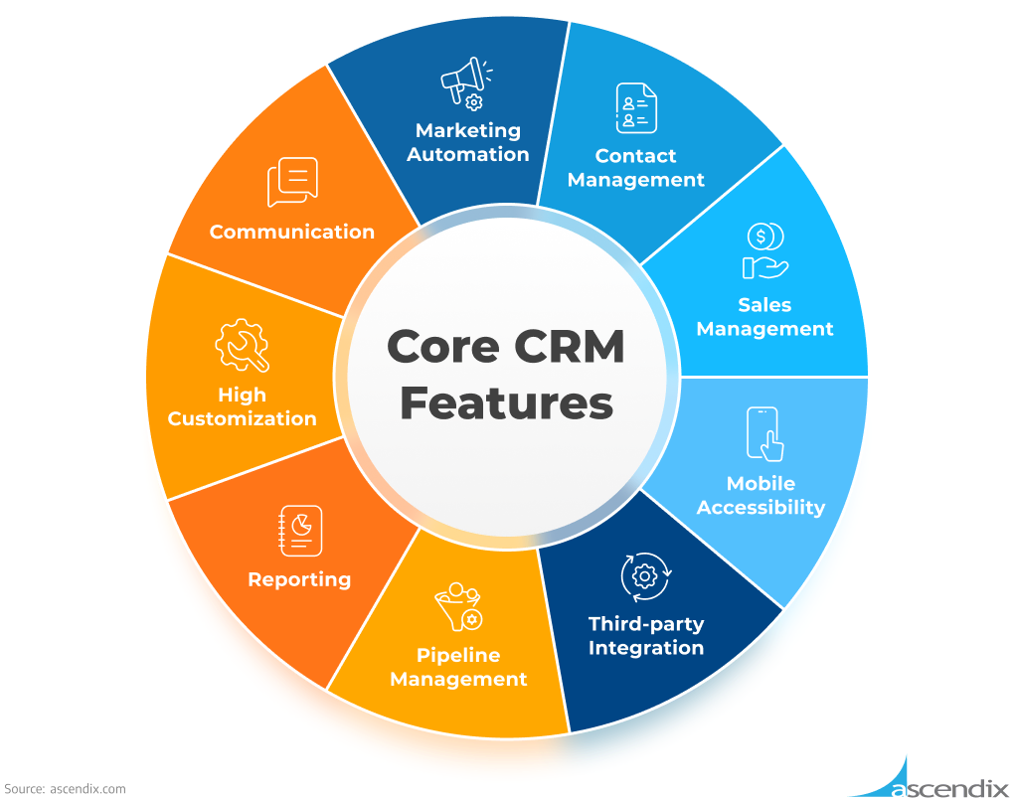
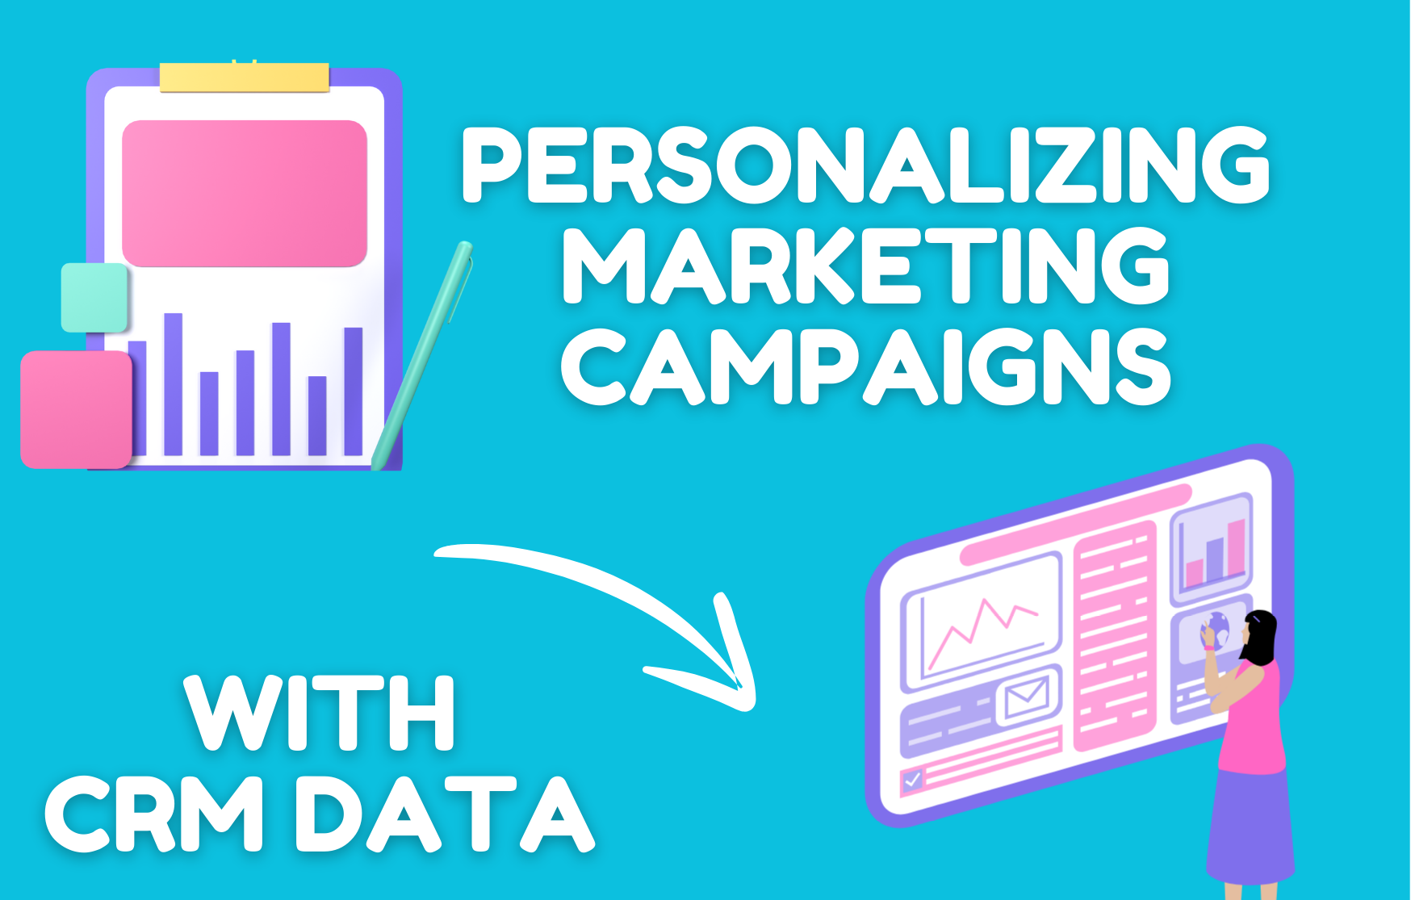
CRM systems play a crucial role in managing these interactions, tracking leads, and segmenting audiences for personalized messaging. For example, a CRM could record interactions from online inquiries, career fairs, and recruiter contacts, allowing for tailored follow-ups based on individual interests and qualifications. (https://ascendix.com/blog/who-uses-crm/).

Slide 6

This ensures that the Army's message resonates with the right audience, fostering a positive initial impression and driving potential recruits towards the next stage (Baldor, 2024).

Slide 7


Customer conversion, in the Army's context, is the process of guiding recruits through the enlistment process. This includes rigorous physical and aptitude testing, background checks, and detailed interviews. A CRM system is essential for managing this complex workflow, ensuring timely communication and tracking each recruit's progress. Business Analysts would use CRM data to identify bottlenecks in the process, such as delays in processing paperwork or scheduling appointments, and recommend process improvements to streamline enlistment (A Midlevel Manager’s Guide to the GCSS-Army Conversion, 2018). .

Slide 8
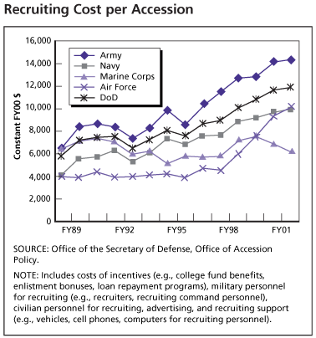
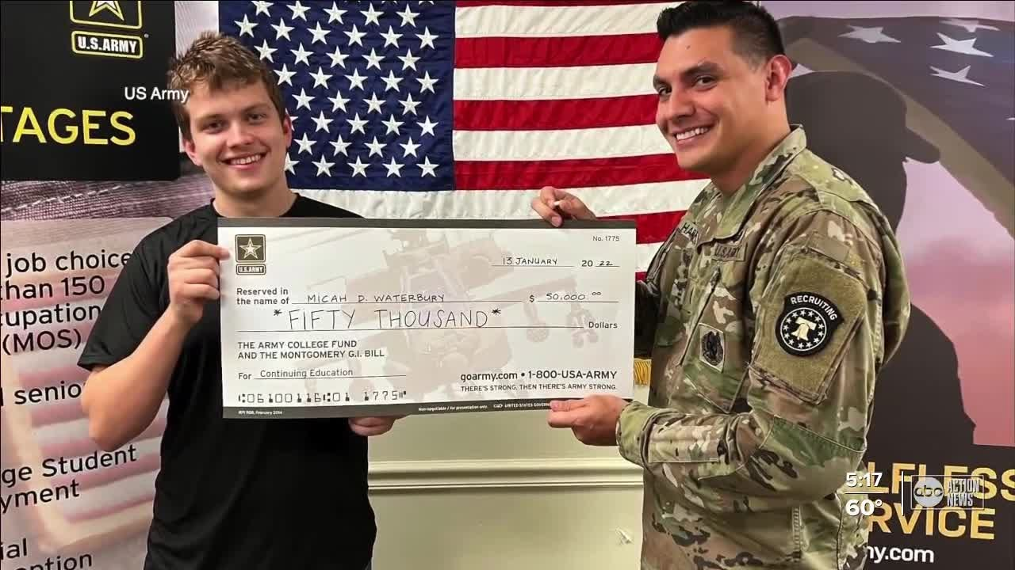
Reporting functionalities within the CRM would provide insights into conversion rates at each stage, highlighting areas where additional resources or support may be needed. For instance, a report could reveal that a significant number of recruits drop out during the medical screening phase, prompting the Army to review and potentially simplify the process (Ingram, 2024).

Slide 9


Customer retention, or soldier retention, is vital for maintaining a strong and experienced force. CRM systems can be used to track soldier performance, training completion, and career progression. Business Analysts would analyze this data to identify factors that contribute to soldier satisfaction and retention. Regular surveys and feedback mechanisms can be integrated into the CRM to gather insights into soldier morale and identify potential issues (U.S. Army Central, n.d.).

Slide 10

For instance, the CRM could track feedback related to housing, benefits, and career development opportunities. Reporting dashboards can provide real-time insights into retention rates across different units and specialties, allowing commanders to proactively address concerns and implement targeted retention strategies. By understanding the factors that influence soldier retention, the Army can implement programs and policies that foster a positive and supportive environment, reducing churn and ensuring a stable and experienced workforce. (MDW Recognizes Excellence in Army Retention, 2024)

Slide 11


Reducing customer churn, or soldier attrition, involves addressing the root causes of dissatisfaction and implementing proactive retention strategies. Business Analysts would delve into exit interview data and CRM records to identify patterns and trends that contribute to attrition. For example, analysis might reveal that a significant number of soldiers leave after their first term due to limited career advancement opportunities or family-related issues.

Slide 12


The Army can then develop targeted programs, such as mentorship initiatives or flexible deployment options, to address these concerns. CRM systems can be used to track the effectiveness of these programs and make adjustments as needed.

Slide 13


By continuously monitoring and analyzing retention data, the Army can refine its strategies and create a culture of support that fosters long-term commitment. This data driven approach will help the Army to keep its best soldiers, and to improve the overall quality of the force.

Slide 14
References
A midlevel manager’s guide to the GCSS-Army conversion. (2018, March 8). www.army.mil. https://www.army.mil/article/201228/a_midlevel_managers_guide_to_the_gcss_army_conversion
Baldor, L. (2024, September 26). Military recruiting rebounds after several tough years, but challenges remain | AP News. AP News. https://apnews.com/article/military-recruiting-army-shortfalls-enlist-1611ea378b32826cc4615dc3731f3f70
Ingram, A. (2024, December 27). Creating powerful CRM reports: Essential types and how to make them. Bonsai. https://www.hellobonsai.com/blog/crm-report
Outreach and Community Relations | The United States Army. (n.d.). Outreach and Community Relations | the United States Army. https://www.army.mil/outreach/
U.S. Army Central. (n.d.). U.S. Army Central retention team “above glide.” https://www.usarcent.army.mil/News/Article/3001182/us-army-central-retention-team-above-glide/

Slide 15
Thank you for viewing my PowerPoint.
Gordon Elliott Williams
Unit 2: Strategies for Customer Acquisition and Retention
BIA540-30 Customer Relationship Management
Dr. Mike Saxton

